Slide 1
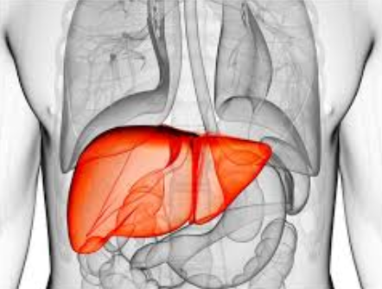
The liver Ruler of the Abdomen
Gil Ben Yakov, MD
Liver Disease Branch
National Institute of Diabetes and Digestive
And Kidney Diseases
National Institutes of Health

Slide 2
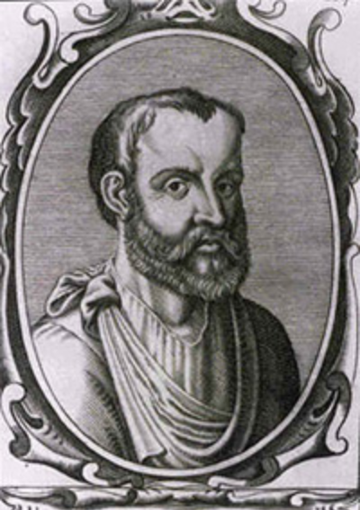
200 AD – "The liver is the source of the veins and the principal instrument of sanguification,"--- Claudius Galenus

Slide 3
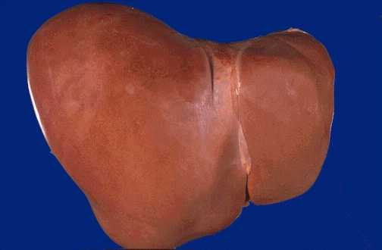
Normal Liver

Slide 4
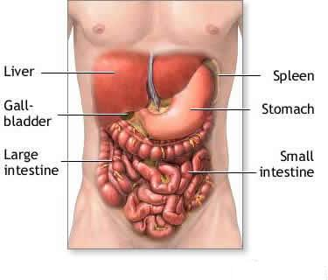
Anatomy
Largest gland in the body (1.5 Kg)
Under the diaphragm, within the rib cage in the upper right quadrant of the abdomen

Slide 5
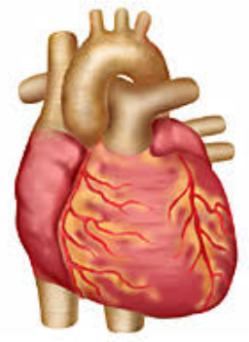
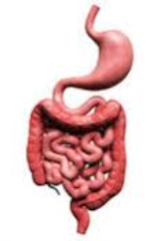
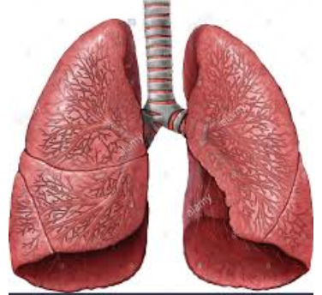
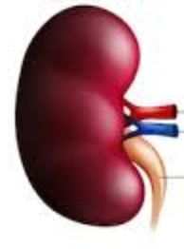
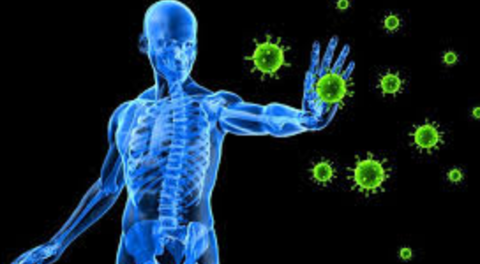
A Hepatologist’s Perspective
The Liver
SUPPLY BLOOD
Feed
Oxygen supply
Protects
Holds liver in place

Slide 6
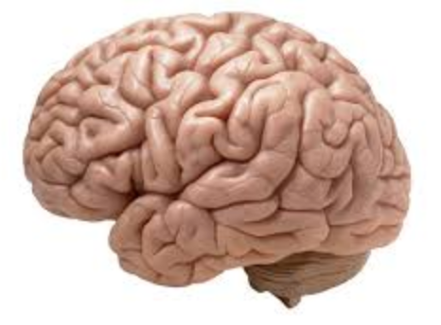
Oh…
Likes to think it’s a liver !

Slide 7
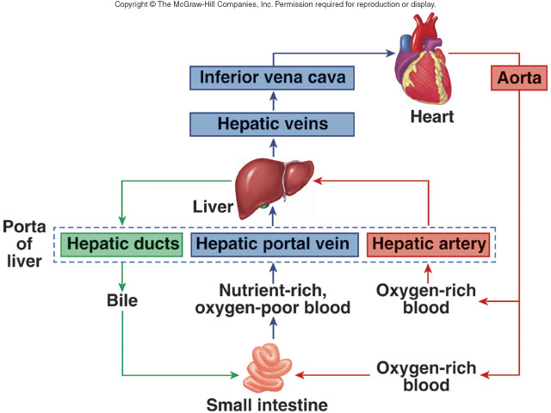
General Public’s Perspective

Slide 8
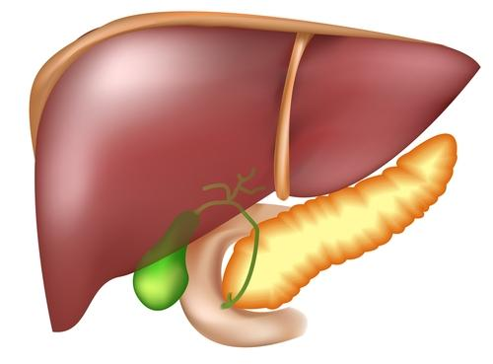
The liver is a real multitasker
Performs more than 500 functions (Zakim and Boyer)
Immune Functions
Storage
Nutrient Metabolism
Homeostasis
Protein Synthesis

Slide 9
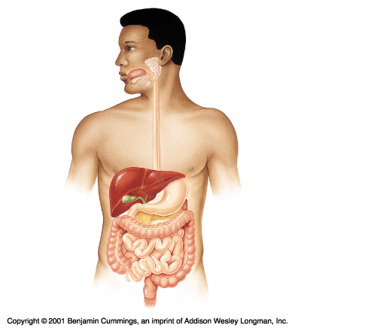
BILE
Liver produces 0.5-1 l of
bile daily
Bile salts emulsify fats
Composed of bile salts, bile pigments, cholesterol, neutral fats, phospholipids and electrolytes

Slide 10
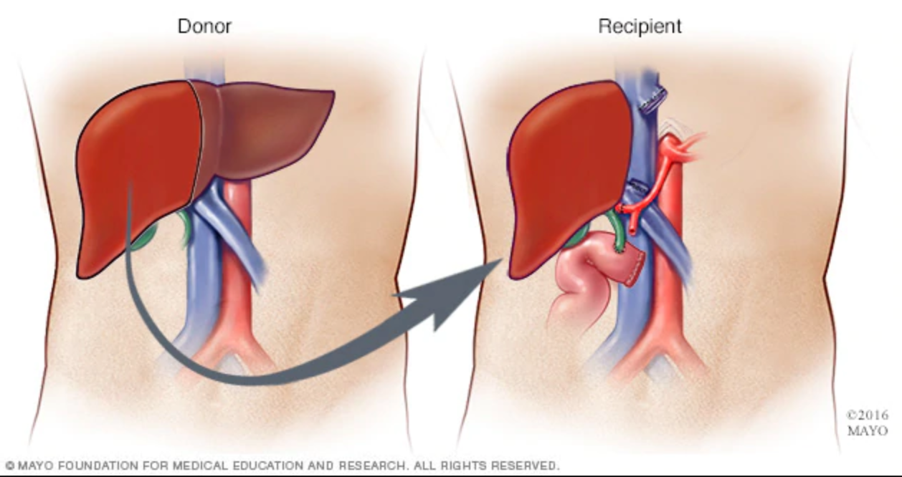
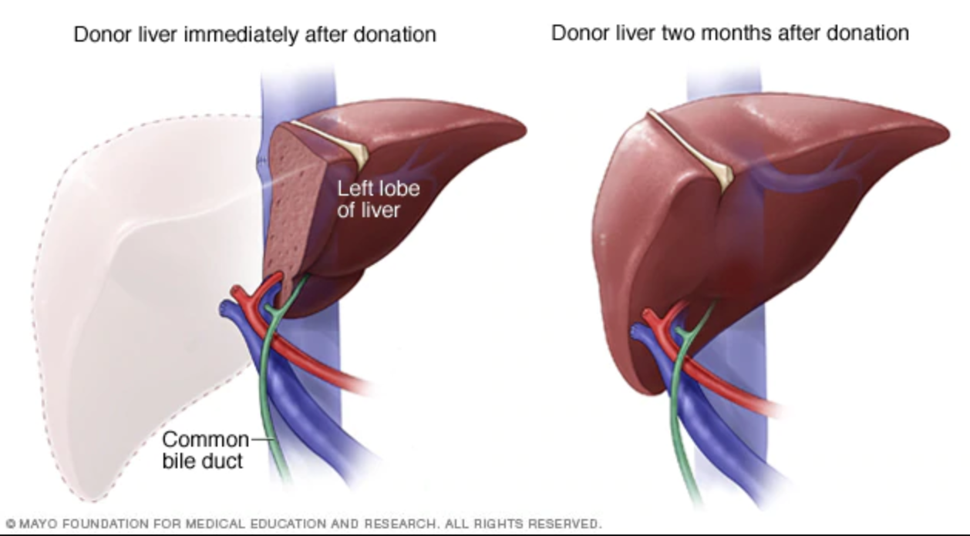
The Liver is Irreplaceable!
No artificial machine or technology can replace the liver
A liver can be replaced only by liver
However has an unbelievable ability of regeneration

Slide 11
CT Upper abdomen - Normal

Slide 12
So what can go wrong with this perfect organ?
Hepatitis = inflammation of the liver tissue
Can be caused by Viruses, Alcohol, Immune response, Drugs & Toxins, Metabolic syndrome (obesity)
Can be manifests as Acute, Chronic or Fulminant

Slide 13
Viral Hepatitis
Specific – Hepatitis A, B, C, D, E
Systemic - CMV, EBV, other.
Virus | Hepatitis A | Hepatitis B | Hepatitis C
Transmission | Fecal/Oral | STD/Blood | Blood
Presentation | Acute | Acute/Sub-Acute | Sub-Acute
Chronicity | None | ~0.5-1% | >50%
Disease Course | Self-limiting | Can be controlled | Curable
Vaccine | Available | Available | None

Slide 14
Autoimmune Liver Disease
etiology Unknown
The immune system attacks the liver tissue
Usually chronic lifelong diseases
Can target hepatocytes (Auto immune hepatitis)
AIH is commonly treated with immune suppression
Can target biliary cells (PBC, PSC)
PBC commonly treated effectively with URSO
PSC no effective treatment

Slide 15
Alcoholic Liver Injury
Exposure to heavy alcohol intake
Common cause of acute/Chronic liver disease
Damage
Fatty change
Acute hepatitis
Chronic hepatitis with scaring
Cirrhosis, Chronic Liver failure

Slide 16
Fatty Liver - NAFLD
The most common cause of liver disturbance in the developed world
Up to 30% of population
Typically paired with obesity
An increasing cause of liver cancer and replacing HCV as leading indication for Liver transplantation
Can manifest as benign (Fatty Liver) or inflammatory (NASH)
NASH is a leading cause for cirrhosis

Slide 17
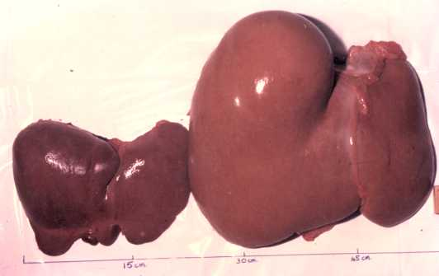
Fatty Liver

Slide 18
All roads lead to cirrhosis

Slide 19
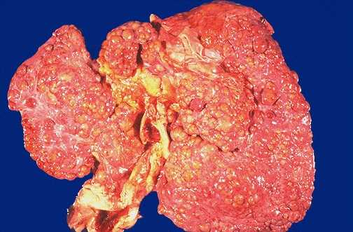
Cirrhosis

Slide 20
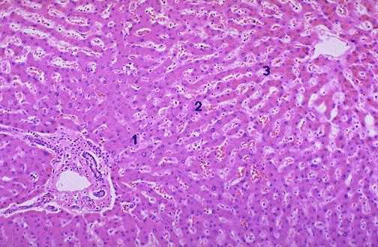
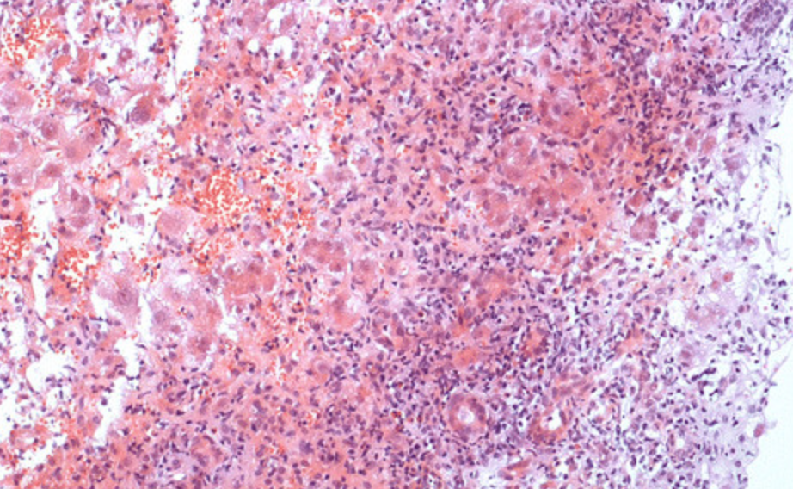
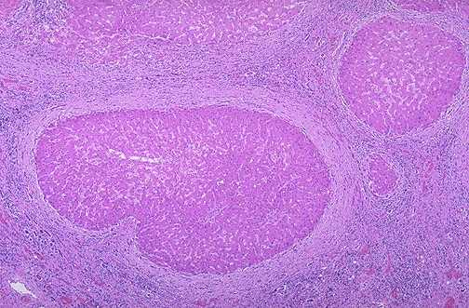
Normal
Inflammation
Cirrhosis (Scarring)
Usually takes years
(Time for intervention)

Slide 21
Cirrhosis
Cirrhosis is common end result of many chronic liver disorders.
A result of long term regenerative processes
Diffuse scarring of liver – follows injury of hepatitis.
Loss of normal architecture & function.

Slide 22
Clinical Features
Hepatocellular failure
Impaired liver synthetic function, malnutrition, low clotting factors, tendency to bleed
Portal hypertension
Ascites, Portal systemic shunts, varices, splenomegaly, hepatic encephalopathy

Slide 23
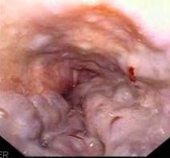
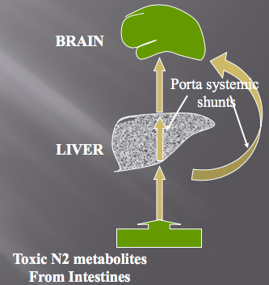
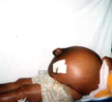
Portal HTN
Esophageal Varices
Encephalopathy
Ascites

Slide 24
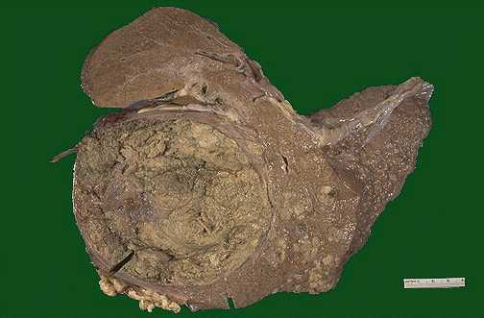
Hepatocellular Carcinoma (HCC)
Mostly in patient with cirrhosis
Cirrhotic patients should be screened with US q 6 months
Most common primary liver cancer
Highly aggressive if not diagnosed early
3rd most common cause of cancer related death
Incidence is increasing while other leading cancers decrease

Slide 25
HCC Incidence
6th most common cancer
Ferlay J et al. GLOBOCAN 2012 v1.1, Cancer Incidence and Mortality Worldwide: IARC CancerBase No. 11 [Internet]. Lyon, France: International Agency for Research on Cancer; 2014.

Slide 26
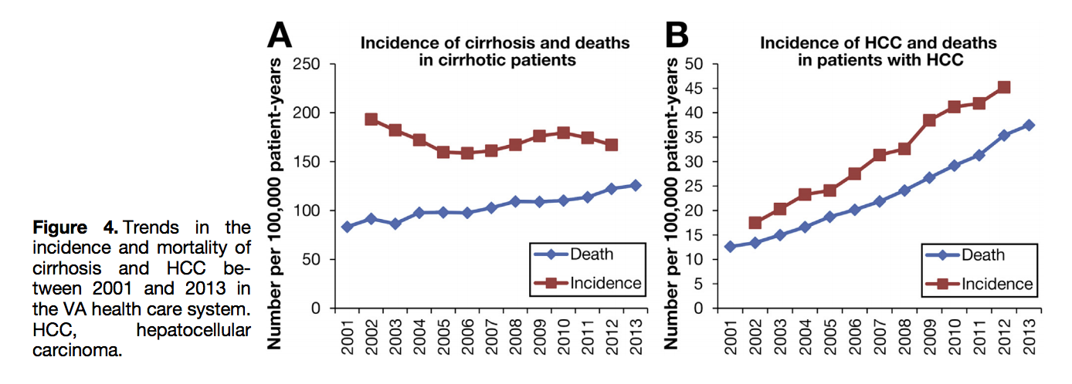
Increasing HCC Incidence
Trends in Burden of Cirrhosis and Hepatocellular Carcinoma by Underlying
Liver Disease in US Veterans, 2001–2013
Beste et al Gastroenterology 2015; 149: 1471-1482

Slide 27
Summary
The liver is irreplaceable.
Many causes but same result – Cirrhosis
Most liver diseases progress slowly with long time of reversible injury and ability to regenerate,
Hence early intervention is of high importance and can change the course of disease
Fatty liver is a rising pandemic and a major concern – should by addressed by both
scientists and regulators

Slide 28
Don’t be chopped liver Help us Live(R) long and prosper

